Slide 1

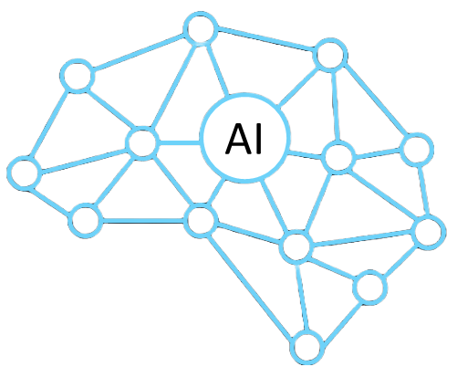
The AI boom
The Growth and Impact of Artificial Intelligence (AI):
A Decade of Trends in Investment, Research, and Adoption
Presented by Angus Kekwick

Slide 2
Overview
01
02
Objective
Key Facts
03
04
Findings
Conclusions

Slide 3
Objective
Situation: AI has rapidly transitioned from a niche research area to a mainstream technology, with a surge in AI-powered products and services.
Complication:This AI revolution has reshaped the technological landscape and significantly influenced the direction and priorities of companies across various industries.
Question: Could the current AI boom have been predicted by analysing academic research trends and public interest?
Aim: Examine AI-related academic paper datasets and Google Trends data to identify key milestones, shifts in focus, and public sentiment that may have foreshadowed the current AI revolution and its impact on the field and society.

Slide 4



Integrating Insights from Three Key Sources
Google Trends
Semantic Scholar.org
Utilised pytrends library to gather public-focused data.
Collected citation count and institution data using an API key and arXiv paper IDs.
Arxiv.org
Kaggle.com dataset containing metadata of academic papers from arXiv.org.

Slide 5



Key Dataset Facts
Time Period covered:
17 years
Total Papers Tracked:
2,565,030
File size:
4 Gigabyte
Papers accessed:
299,652 (600 requests)
Academic institutions represented:
12,872
Cumulative AI paper citations:
13,311,416
Countries represented
251
Time Period covered
20 years

Slide 6
AI Key Events
2016
AlphaGo beats the world’s Go champion
AlphaGo
2017
‘Transformers' discovered, enabling large language models (LLMs)
Transformer
2018
OpenAI releases GPT-1
GPT-1
2020
AlphaFold wins protein folding contest
AlphaFold
2022
OpenAI releases ChatGPT to public
ChatGPT

Slide 7
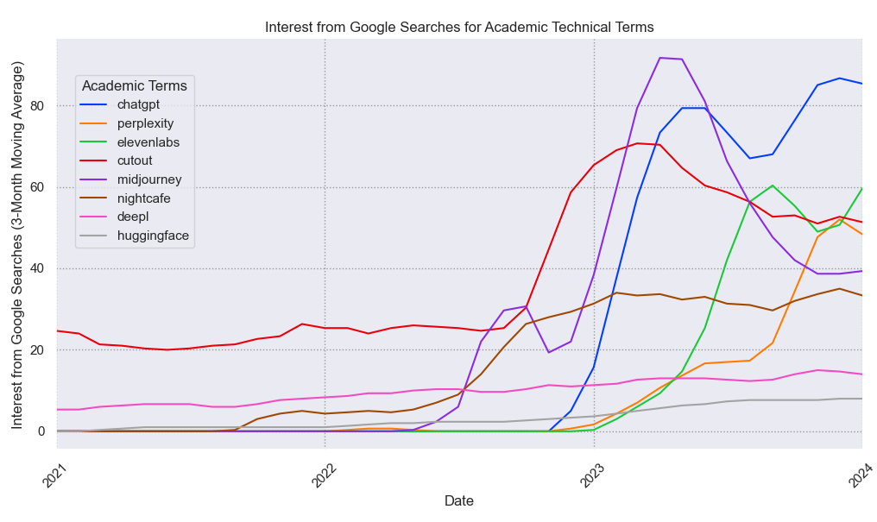
Tracing the AI Boom: Google Search Trends and Key Product Releases
In 2022 May
In 2022 July
In 2022 November
Cutout Pro releases AI art
Mid Journey Released
ChatGPT is released
Google Search Data: Modern AI boom begins late 2022
Source: Google.com Trends API

Slide 8
Obtaining all AI Research
3. Artificial Intelligence
2. Computer Vision and Pattern Recognition
4. Machine Learning
5. Neural and Evolutionary Computing
Computation and Language
5 arXiv categories directly related to AI where used as the ‘AI’ category does not include all AI research
'Artificial Intelligence', 'Computer Vision and Pattern Recognition', 'Machine Learning',
'Neural and Evolutionary Computing', 'Computation and Language'

Slide 9


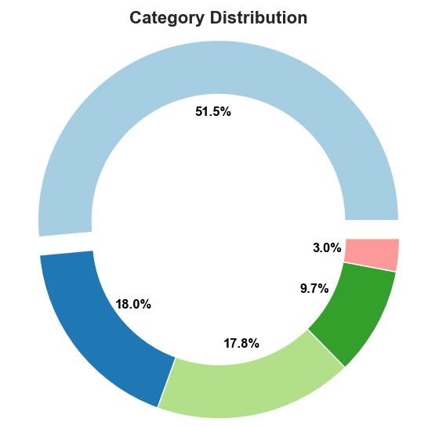
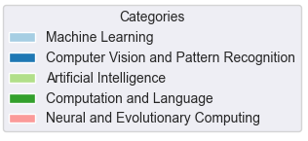
Breakdown of Research Categories
The AI category, excludes certain AI areas to enable more precise categorisation.
Computation and Language (CL) covers Natural Language Processing (NLP) which played a significant role in modern Large Language Model (LLM) AI services like ChatGPT.
Robotics category excluded
Machine Learning (ML) dominates primary categories and is listed on the majority of AI papers
Tallied counts of primary research categories for each paper
Source: arxiv.org AI academic papers metadata

Slide 10
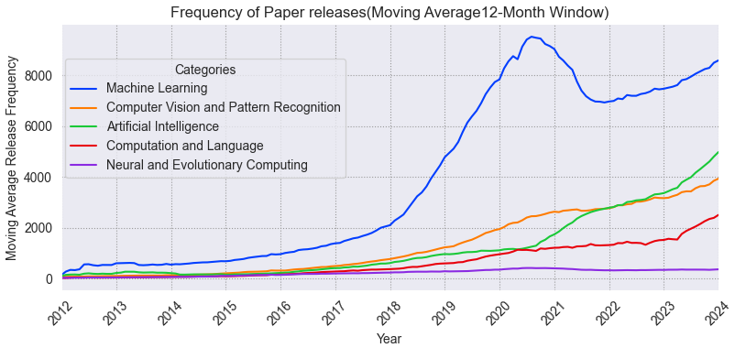
Surging Momentum: The Rise of AI Paper Publications, 2013-2023
In 2017
In 2018
In 2022
Chat-GPT
Transformers are proposed
GPT-1
Transformers
GPT-1 is released
Chat-GPT is released to the public
covid
Source: arxiv.org AI academic papers metadata

Slide 11
Surging Momentum: The Rise of AI Paper Publications, 2013-2023
Papers released 4x in 3 years between 2017 and 2020.
Machine Learning growth spiked started in 2018.
Other categories' caught up, spiking at the beginning of 2020.
Chat-GPT
GPT-1
Transformers
All AI categories have shown consistent, significant growth over the last decade (excluding covid).
covid
Source: arxiv.org AI academic papers metadata

Slide 12
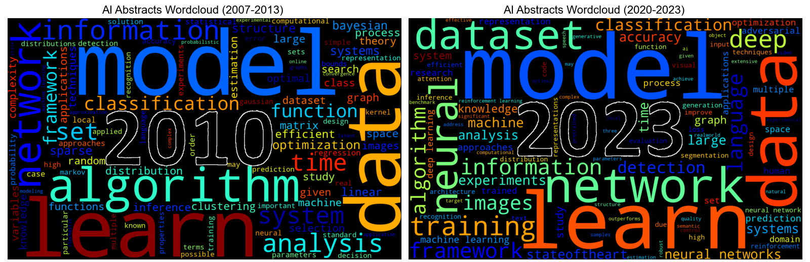
Evolving Lexicon: AI Research Wordclouds, 2007-2013 vs 2020-2023
Source: arxiv.org AI academic papers abstract and title data
Wordclouds reveal consistent terms like "models", "learn", "data", and "network", emphasizing continuing importance in AI research.

Slide 13
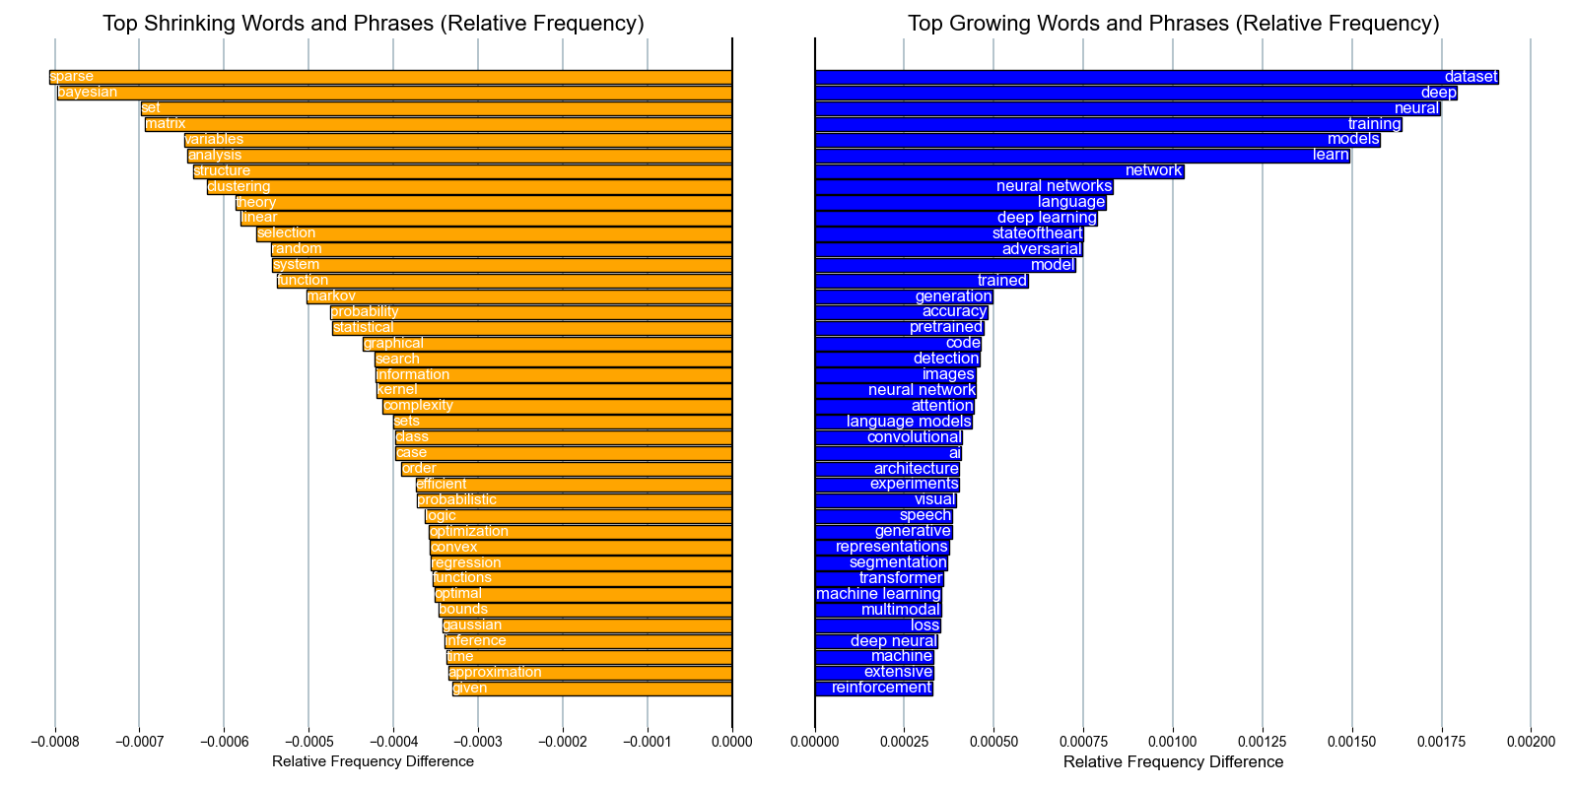
Shifting Terminology: Growing and Shrinking Words and Phrases in AI Research 2007-2013 vs 2020-2023
Shrinking use reveals that terms such as "Bayesian statistics" and "algorithm" have diminished in prominence within contemporary research.
Statistical terms have experienced a decline in usage, suggesting a shift in the mathematical focus of current AI models compared to earlier research.
Growing use illuminates key trends in the AI boom. Modelling and training on datasets emerge as central drivers of development.
These insights warrant further examination to better understand the trajectory of AI research and its implications.
Source: arxiv.org AI academic papers abstract and title data

Slide 14
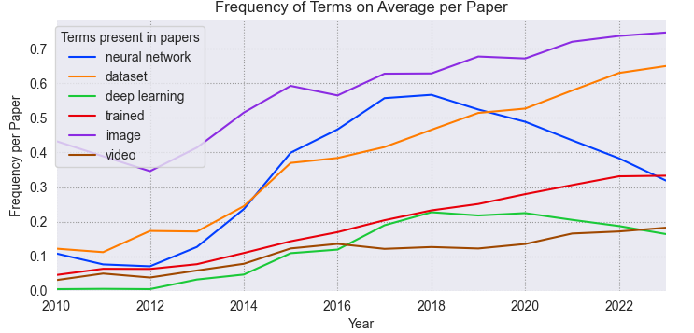
Trending Topics: Phrase Frequency in AI Papers Over Time
Image and video data reflect the growth of Computer Vision and Pattern Recognition field, and the rise of multimodal models combining data types like image and text.
Training on datasets emerges as a fundamental aspect of most current AI models.
The surge in LLMs follows the publication of OpenAI's influential papers.
LLMs, dataset training, and image recognition correlative with and are key drivers of the current AI boom.
Source: arxiv.org AI academic papers abstract and title data

Slide 15
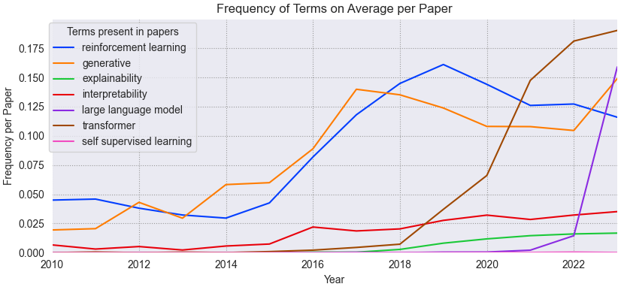
Trending Topics: Phrase Frequency in AI Papers Over Time
The Transformer architecture exhibits significant growth, closely correlating with the AI boom.
Generative models steadily rise, leading to products like Midjourney and Cutout Pro
Self-supervised and reinforcement learning techniques grow in prominence, with
reinforcement learning as the favored approach
Explainability and interpretability have grown since 2018, potentially indicating an emerging AI research trend
Source: arxiv.org AI academic papers abstract and title data

Slide 16
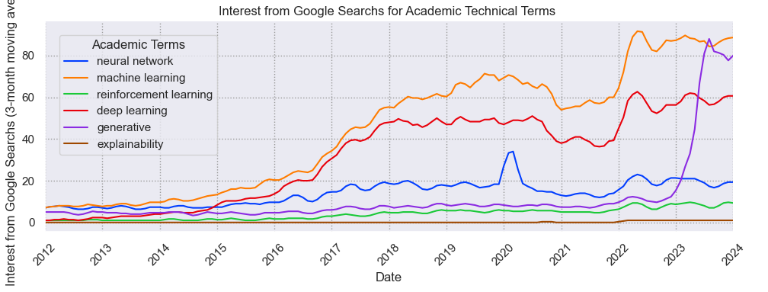
Trending Topics: Google Search Data
AI academic keyword searches trend upward from 2017, with a second spike in 2022, coinciding with the rise of AI products.
"Generative" grows consistently, surging dramatically in 2023 as it becomes a publicly recognized term for AI image generators services.
Source: Google.com Trends API
Google searches for AI academic keywords reflect research trends, with AI topics showing substantial growth in public interest and awareness

Slide 17
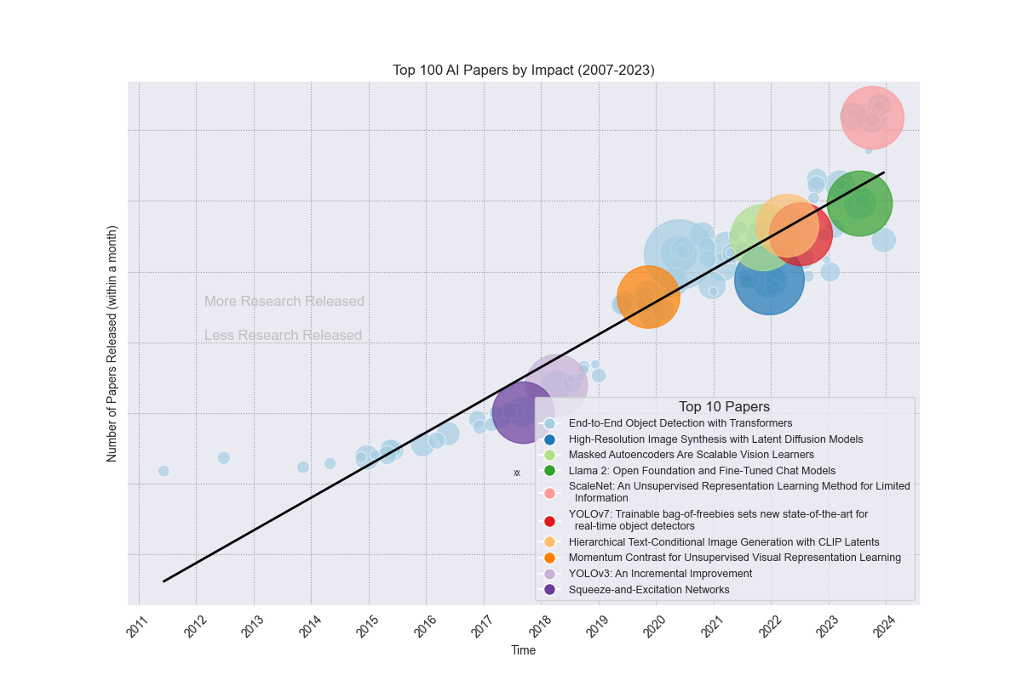
Groundbreaking Research: Top 100 Influential AI Papers, 2013-2023
Linear regression model shows consistent upward trend in AI paper releases
Top-ranked paper based on z-score involves Transformers, extensively used in current AI products like ChatGPT
Computer vision and image detection are prominent, with 6 of the top 10 most impactful papers focusing on these areas.
Add info on most recent impactful paper scalenet
Most of the impactful AI papers were published recently, with 6 of the all-time most influential papers in the last 2 years since the AI boom began
Bubbles represent citation counts relative to contemporary papers, mitigating bias favoring older papers
Source: semantic scholar API and arxiv.org AI academic papers metadata

Slide 18
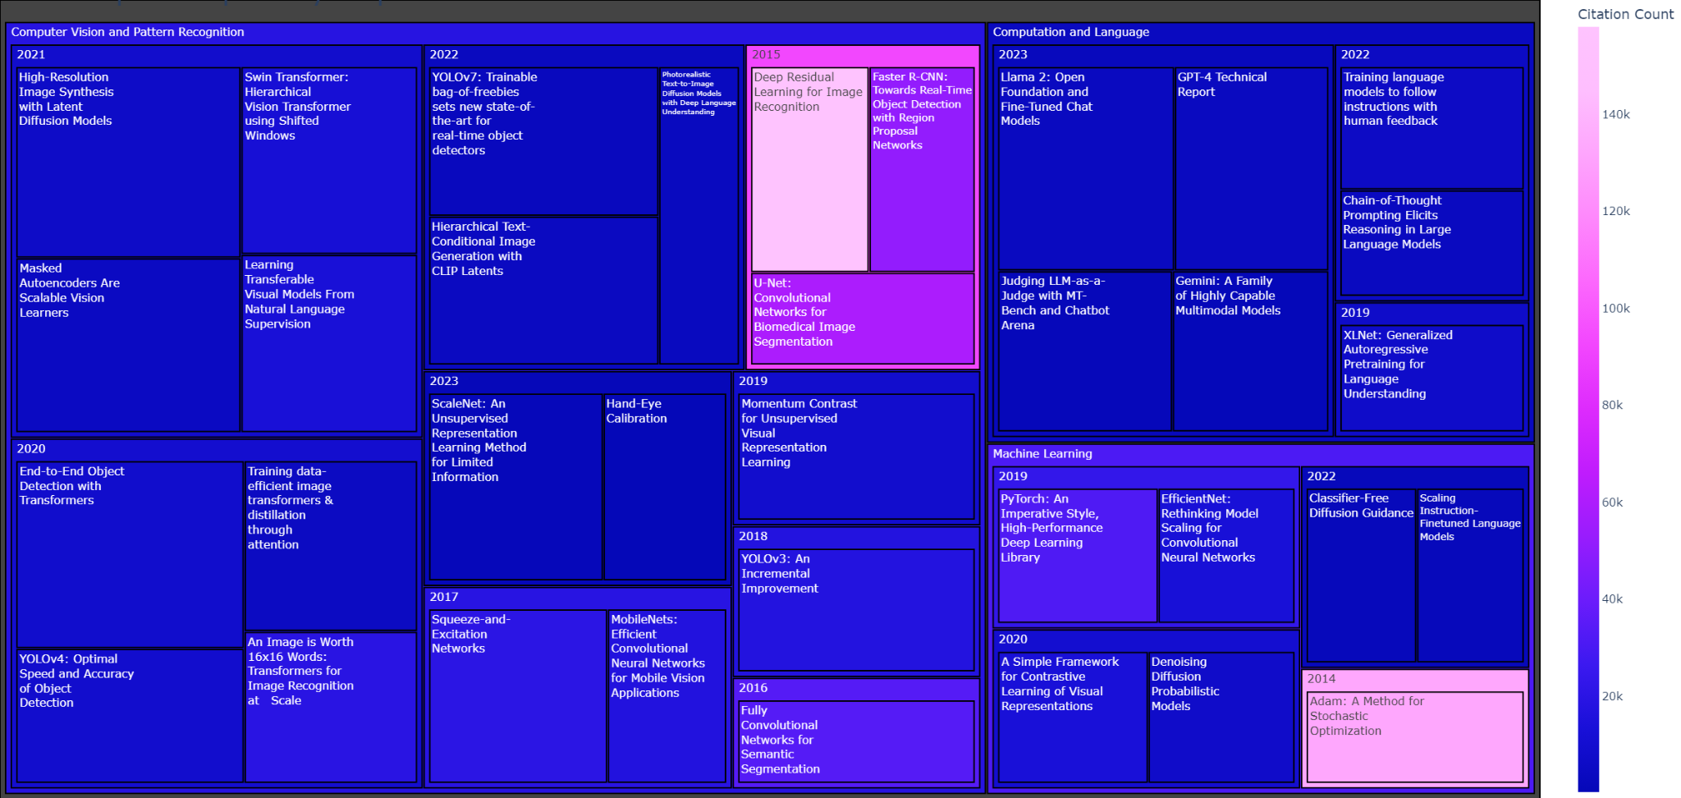
Trailblazers: Dissecting the Top 35 AI Papers by Impact, Category, and Publication Date
Significant proportion of influential papers have been published in the last 4 years, despite data spanning the previous decade
Two papers from 2014-2015 have the highest citation counts, suggesting they have shaped AI research direction since publication
Computer vision leads in impactful research, but computation and language show influential papers in 2022-2023, potentially indicating a future trend
Size representing impact and colour denotes citation count
Source: semantic scholar API and arxiv.org AI academic papers metadata

Slide 19
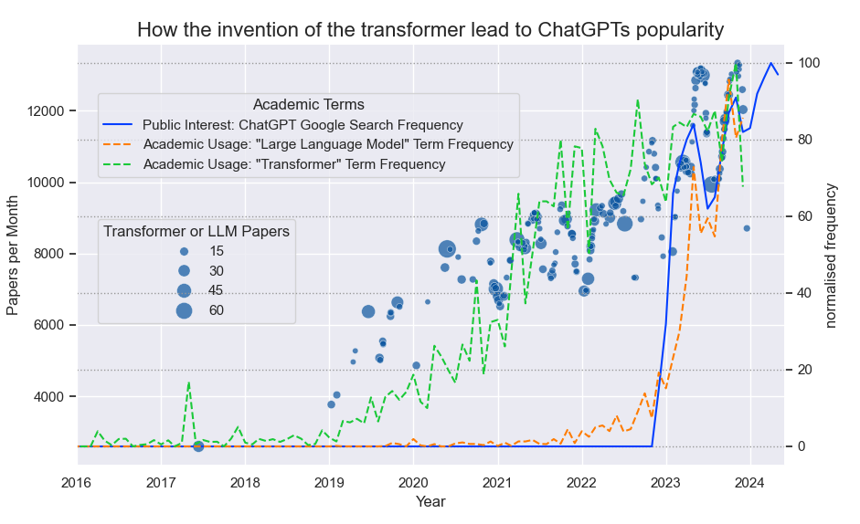
‘Transformers’ Unraveled: Tracing the Impact of Pivotal Papers, Research Trends, and ChatGPT's Influence
"Attention is All You Need" (2017), introduced ‘Transformer’ architecture, sparking research surge
Numerous influential papers on Transformers were published.
Academic usage of ‘Large Language Model’ correlates with Google Search of ‘ChatGPT’ trend, indicating research influenced by ChatGPT's commercial success
LLMs emerged as rapidly growing research area during AI boom
Transformers are discovered
Transformer innovation reached the public through ChatGPT, igniting 2022 AI boom
This analysis combines multiple graphs, plotting the impactful of influential Transformer papers, academic keyword usage in papers, and ChatGPT's Google search data.
Source: Semantic scholar API, Google.com Trends API and arxiv.org AI academic papers metadata

Slide 20
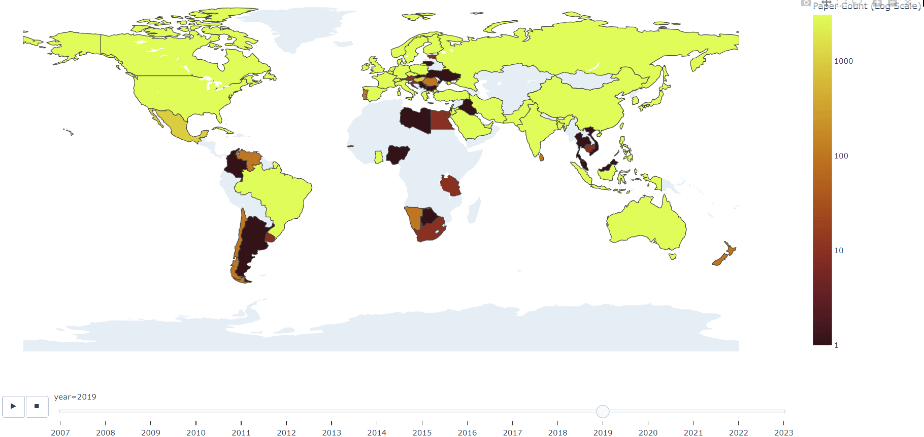
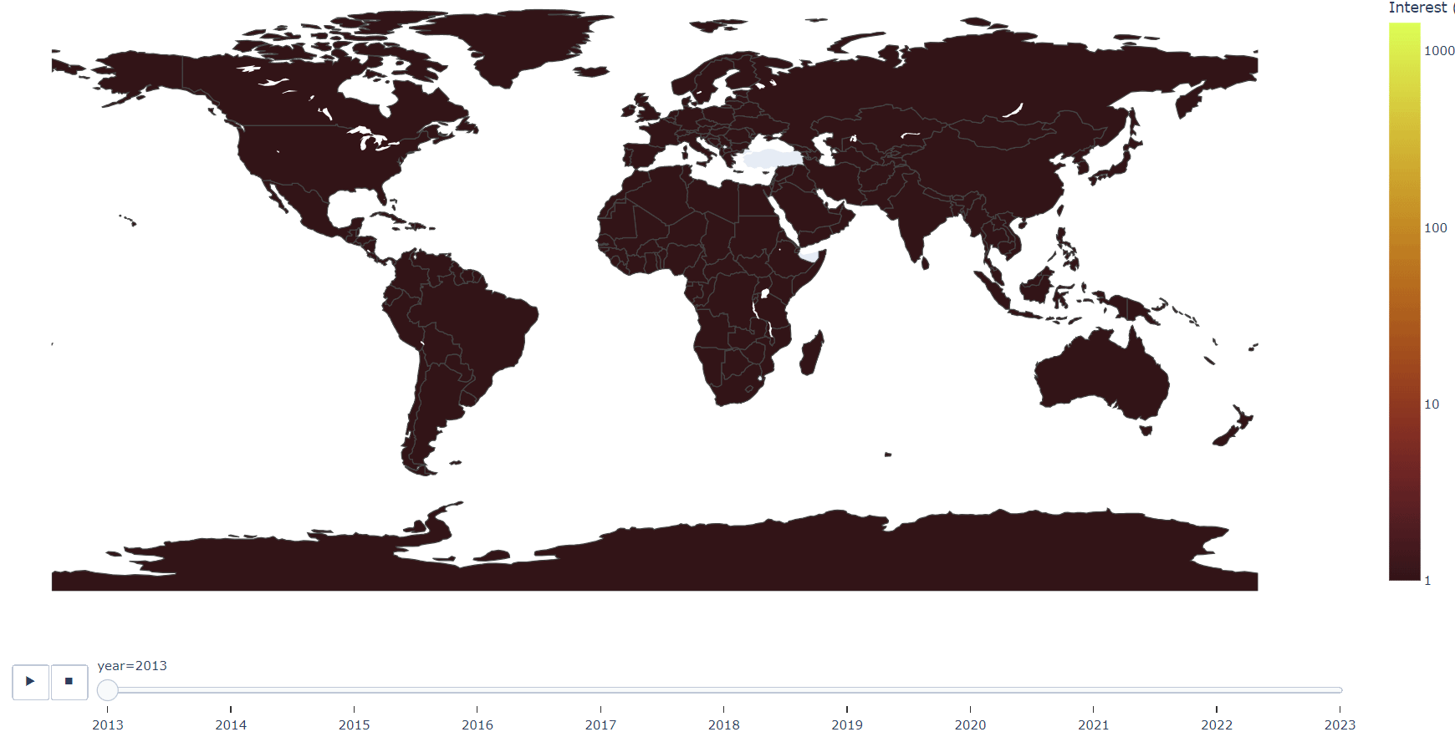
Geographical Disparity: AI Research Hubs vs AI Service Adoption
Source: Semantic scholar API and ‘Universities’ Python library
Source: Google.com Trends API
The map of AI academic papers' publication locations based on the primary author's affiliation shows a centralized distribution, with the USA leading, followed by China and the UK.
In contrast, the map of AI service Google Trends search data reveals a more dispersed user base, with slightly higher concentrations in developed countries with internet access and strong education systems.

Slide 21
Conclusions
The current AI boom could have been anticipated by analysing trends in academic research and public interest. AI paper releases began accelerating in 2017, preceding the product AI boom that started in mid-2022. The delay between research advancements and consumer products could have served as a predictor for the AI product boom.
Trending AI keywords and research areas have directly contributed to successful products. The academic data reveals consistent growth in the frequency of these keywords over the past 5 years, along with a significant number of impactful papers focusing on these topics.
The growth of these research areas may have signalled an impending product boom as the influential and popular research was incorporated into products.
Given the centralised nature of AI research, it is likely that most future AI growth will be concentrated in the USA, closely followed by the UK and China.
Despite machine learning's category majority, computer vision leads in impactful AI research, with computation and language showing promise in 2022-2023 impactful papers, potentially signaling a future trend.
Future AI products may emerge from currently growing research areas, such as scalenet, which has produced impactful papers using deep convolutional neural networks. Driveless cars

Slide 22
Next Steps
Predictive Analysis: Utilise the established relationships between past AI academic paper metadata and subsequent AI industry growth to forecast future trends and growth areas based on AI research from the last 2 years.
Data Modelling: Employ data modelling techniques to analyse current AI trends and leverage them for predictive analysis of future AI developments and their potential impact on the industry.

